Slide 1

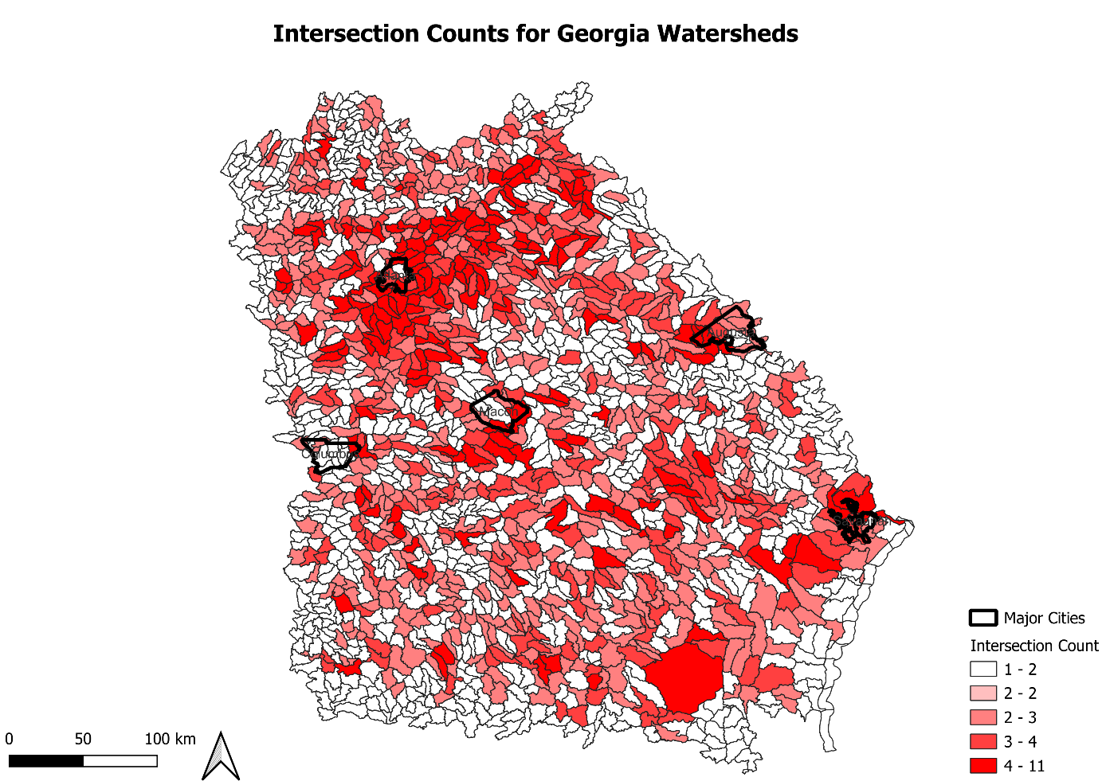
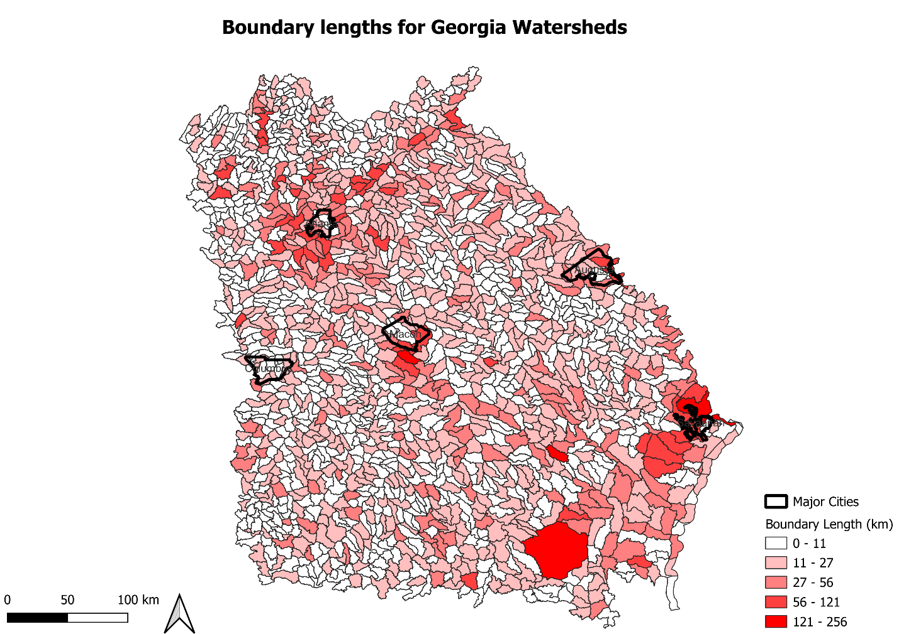
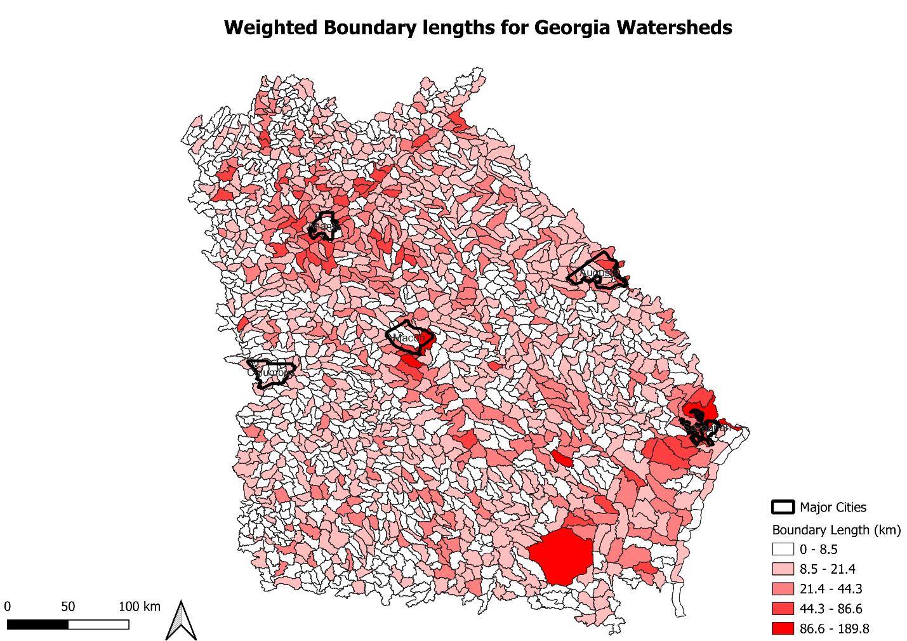
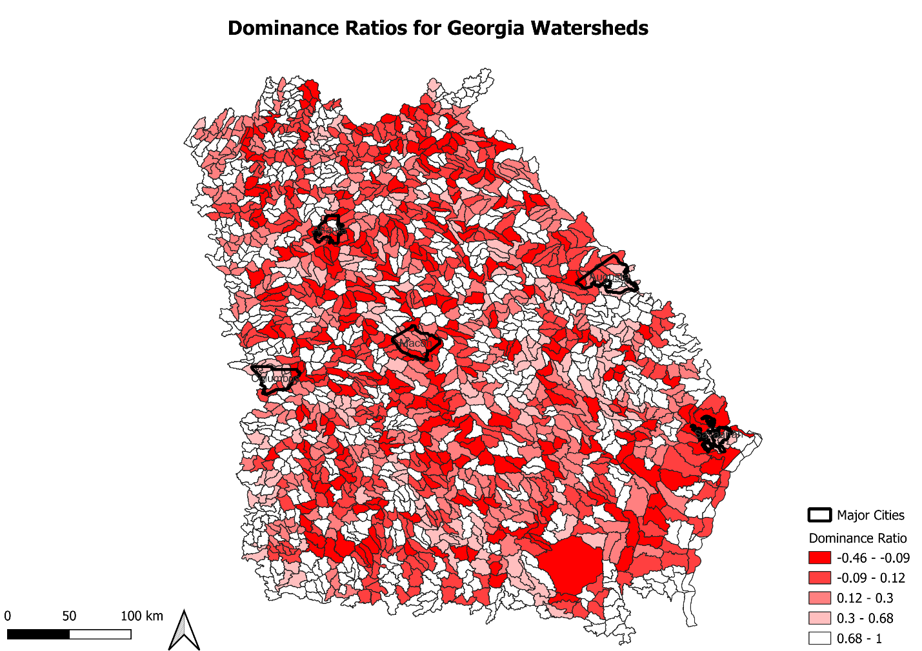
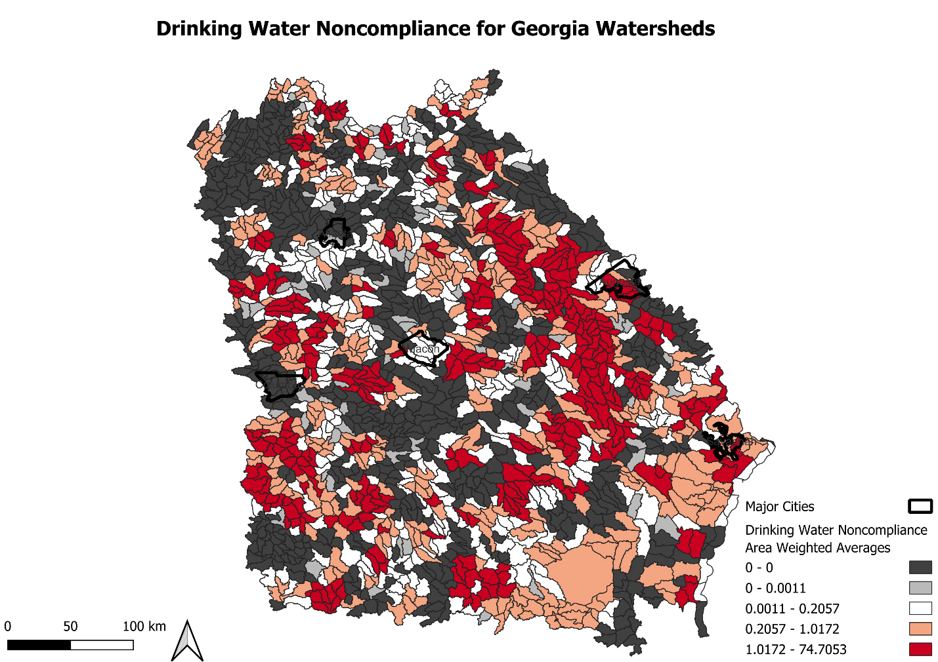
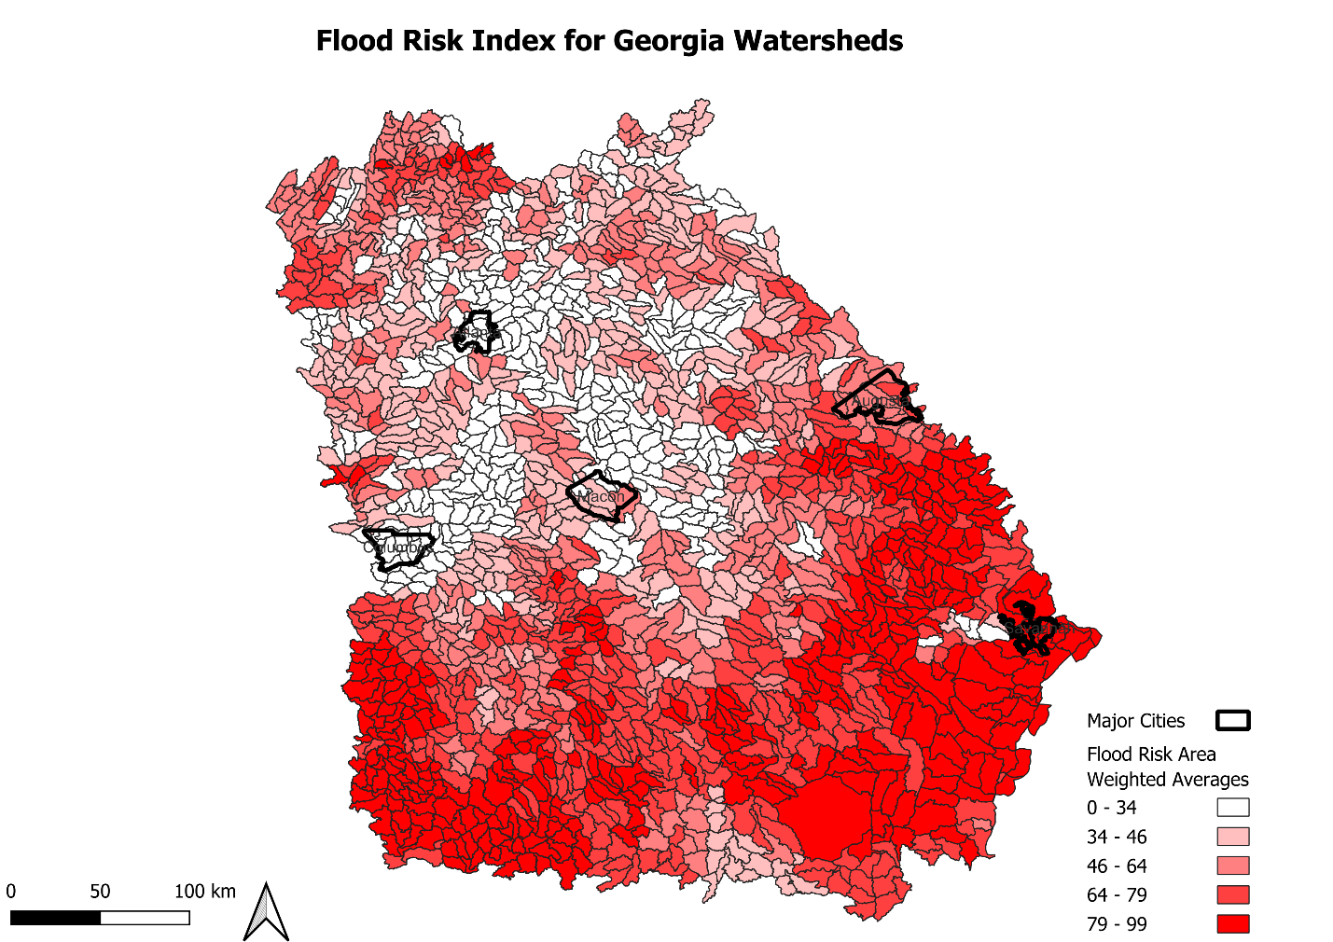
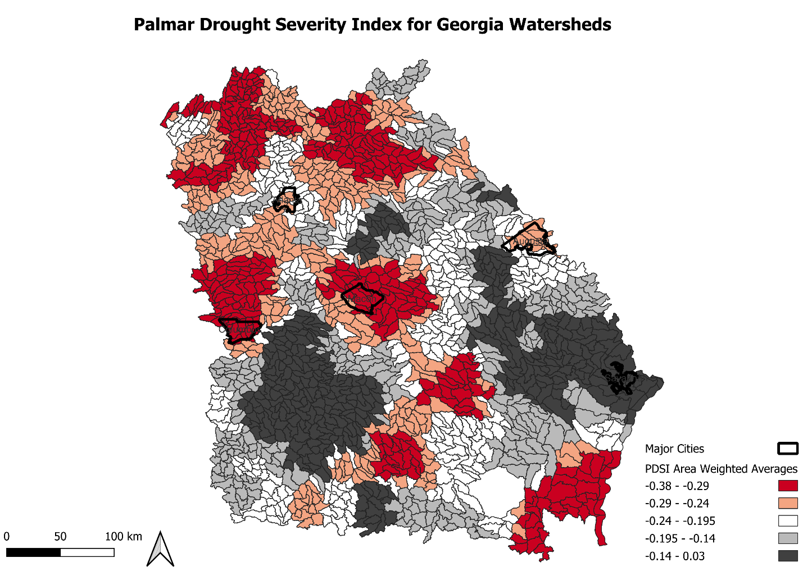
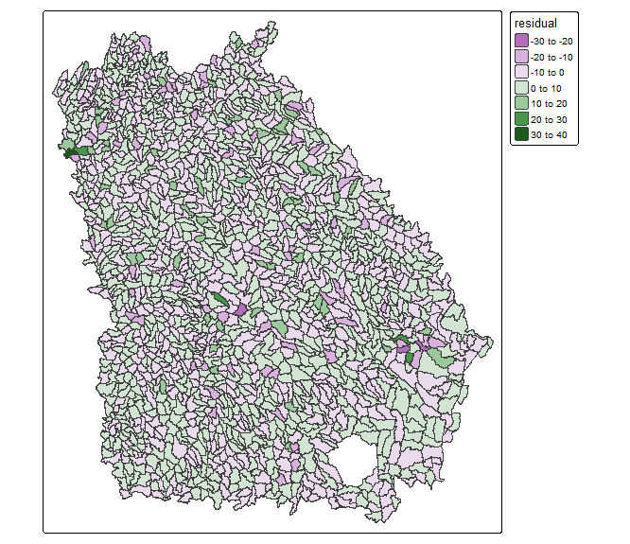
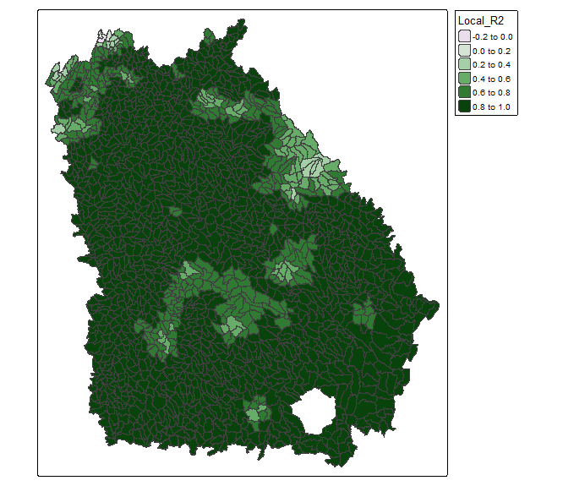
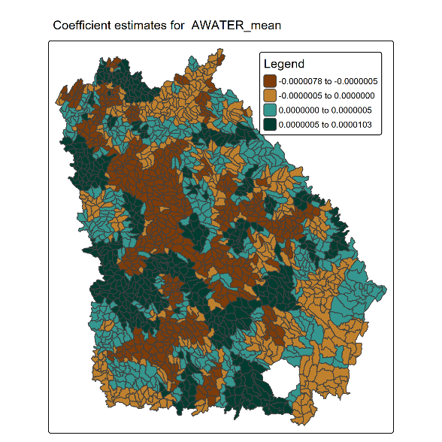
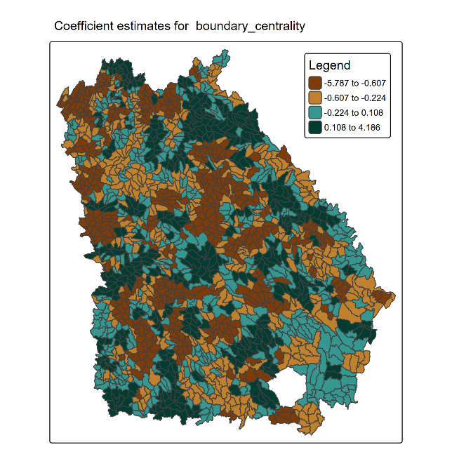
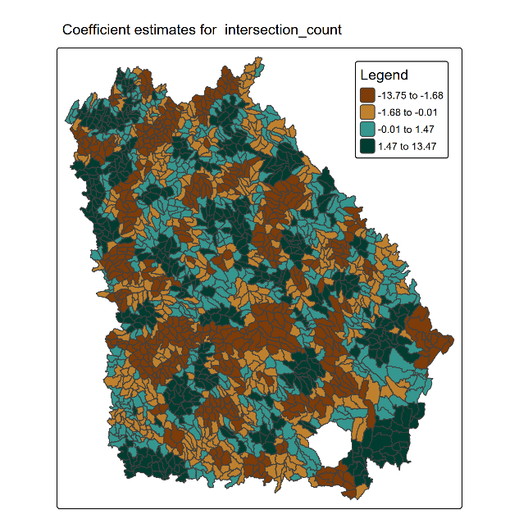
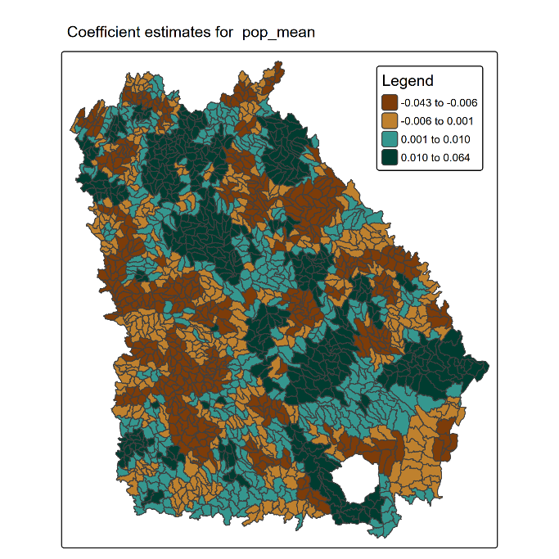
Quantifying divided watershed governance and its correlation with water problem burden.
Andrew John Dowdy, BSc, WFR, SARTECH II
Georgia Institute of Technology
Abstract
Methods
Discussion
Watershed management is often conducted by municipal or county agencies whose jurisdiction ends at the border of their city or county, and not at the border of the watershed. Bio-regionalist thinkers have hypothesized that this represents a substantial boundary to effective watershed governance as it presents challenges for agencies to incentivize water resource stewardship, penalize egregious pollution, and enact adequate flood and drought control measures throughout their watershed. Georgia watersheds were examined and scored according to various metrics measuring the number of local governments responsible for their management, the length of local government boundaries running through them, and the proportion of their control by a single local government. Area weighted averages were created for flood risk, drought severity, and water quality in each watershed. Statistical analysis revealed metrics for divided watershed governance bore no strong association with flood risk in much of the state but were moderately negatively associated with flood risk in parts of the state such as Augusta, and slightly positively associated in other parts of the state, such as in Savannah. Analysis revealed very little association between divided watershed governance and drought severity or water quality. This study reveals the limited and variable influence of local government boundaries on watershed issues.
Watershed were operationalized using southeastern WBD HU12 features tagged as being in Georgia sourced from the USGS.
Four methods of operationalizing watershed dividedness were conducted, resulting in four scores known as intersection count, boundary length, weighted boundary length, and dominance ratio. From these, an index wase built known as boundary centrality, from which an overall watershed dividedness score was created. County and city data was dissolved to create polygons representing different county and municipal jurisdiction. From this data, for each watershed, an intersection count was tallied totaling the number of separate entities with jurisdiction in that watershed. The length of municipal boundaries running through each watershed was accumulated; and a weighted length preferring boundary lines closer to the watershed center was also accumulated. Lastly, a dominance ratio was calculated for each watershed representing the land area ratio between the largest agency having jurisdiction in a watershed and all other agencies having jurisdiction. Boundary centrality was calculated by taking the difference between boundary length and weighted boundary length normalized by weighted boundary length.
Three forms of water problem burden were operationalized, resulting in scores for drought burden, flood hazard, and water quality. All three variables took existing data products and converted them from county or census tract encoding to watershed encoding using area weighted average. Drought burden did so with 1900-2000 county palmar drought severity index averages. Flood hazard did so with FEMA national risk index values. Water quality did so with archived EJScreen figures for drinking water noncompliance and wastewater discharge. These four figures were then combined into a water problem burden score by taking the sum of drinking water noncompliance, wastewater discharge divided by one hundred, flood risk mean, and the absolute value of the PDSI multiplied by one hundred.
Initial OLS regressions were run on each individual variable for a of water problem burden, as well as the overall score, with variables for watershed dividedness as independent variables and variables such as watershed land area, watershed area weighted population, and watershed water area percentage as control variables. Flood risk was the only variable which produced a regression with significant independent variables and an adequate R squared. The flood risk model suffered from significant heteroskedasticity however. Depicted below are maps of each independent and dependent variable as they were operationalized. Therefore, the final model was a geographically weighted model with flood risk as the dependent variable and selected methods of operationalizing watershed dividedness and controlling for other influences on flood risk as independent variables. In no model was dominance ratio a significant variable.
The disparities between the geographically weighted model and its corollary global model suggest to me that location was a far more powerful predictor than any or all of the variables specified in the model. This combined with the failure of the initial OLS models suggest to me that the predictors used, and their associated estimates, are not the best linear unbiased estimates for the whole state of Georgia.
In other words, I believe the modelling attempts show that divided watershed governance, in addition to appearing a poor global and local predictor of general water problem burden, is also a globally unreliable predictor of flood risk. This matches findings of my literature review, in suggesting that divided watershed governance has functioned as an aid to water resource stewardship in some watersheds, and as an impediment in other watersheds.
I therefore believe, at global scale, I have proven the null hypotheses, namely that divided watershed governance is not associated with flood risk, drought severity, or water quality in the state of Georgia. However, I have shown that there is an association between divided watershed governance and flood risk, but that the association varies depending on geographic region. Divided watershed governance appears to be associated with higher flood risk in some municipalities such as Savannah, and lower flood risk in other such as Augusta, according to the geographically weighted regression.
Introduction
Watersheds gather water to a common outlet. I therefore believe that the inhabitants of watersheds often have more water-related problems in common that the inhabitants of counties or cities do. This is reflected in the way residents of the Proctor Creek watershed share problems such as sewage, sediment, and industrial pollutants in their rivers that their neighbors in other watersheds but the same municipalities do not. Water can carry a host of pollutants and hazards from E-Coli to heavy metals to raw sewage and that does so ignoring property lines and political boundaries. Therefore, it follows that if a pollutant is improperly handled a watershed, the pollutant will be the shared burden of the watershed. It also follows that if flooding or drought is poorly controlled in the watershed, it will be the shared burden of the watershed. These problems, which we might call “water problems,” therefore seem much less the function of the actions of individuals, cities, or states, but of the community of a particular watershed.
Therefore, it would appear the way we manage watersheds is fundamentally wrong-headed. Watersheds are ordinarily managed by county, state, and municipal governments. For example, the portions of Chattahoochee watershed that lie within the city of Atlanta, are management by the department of Watershed Management. However, on the other side of the Chattahoochee River, this department has no jurisdiction. In fact, the Proctor Creek-Chattahoochee River watershed unit has no less than 4 different municipal and county agencies managing parts of the land comprising it. It is dissected by over 15 kilometers of municipal boundaries and county lines, despite being only 61.63 square kilometers large. This is what I call a watershed with divided governance. Its inhabitants must redress their grievances over their poisoned creeks with four different political entities, despite not being a constituent of all four. This has provoked some, known as bio-regionalists, to argue that we must rethink the shape of our governments such that citizens are always deemed constituents of the land that their livelihood relies on.
The intention of this paper is to test the hypothesis that there is a correlation between divided watershed governance or “watershed dividedness”, and drought, flooding, and water pollution or “water problem burden” in the state of Georgia.
Conclusions
Results
In conclusion, this research shows that divided watershed governance is a poor predictor of drought severity and water quality, and is only a useful predictor of flood risk in some areas, where it can predictor for higher or lower flood risk. I believe that the spatially variable of the hypothesis that water problem burdens and their causes, often thought to be the poor stewardship of land, are less a function of the political systems that govern a watershed, and more a function of the citizenry of a watershed. By poor stewardship of land, I mainly refer to agricultural practices such as reliance on tilling and nitrogen fertilizer, as well as damning and irrigation, heavy use of impervious surfaces, and improper waste handling. These practices may happen regardless of the governance structure of the watershed and the assignment of its constituents because the constituency is indifferent, ignorant, or powerless. Alternatively, one could hypothesize that water problem burdens are the result of the geographic features of a watershed, not the cultural geography of a watershed.
Future work may attempt to verify or falsify my demonstration of the global null hypothesis. This may involve specifying a different global model, either by quantifying watershed dividedness differently, quantifying water problem burdens differently, or by including alternative control variables. One interesting method of operationalizing the variables differently would be to conduct sensitivity testing by conducting the comparison on a different scale.
Future work may attempt to examine the cultural values, government watershed management practices, and watershed terrain conditions in those watersheds where I have reported a positive or negative coefficient between watershed dividedness and water problem burden. My suspicion is that watersheds where divided governance is positively correlated with water problem burden are ones in which citizens are engaged in favor of water resource stewardship, but governments are not, and that the opposite is true where the correlation is negative. However, it could equally be the result of other factors mentioned or not mentioned.
Additionally, future work may attempt to explain the lack of a relationship between divided watershed governance and water problem burden in select watersheds where I have shown there is no correlation. My suspicion is that the lack of a relationship is a result of the lack of a relationship between divided watershed governance and poor water stewardship. One alternative explanation is that water stewardship and water problem burden are unrelated.
The geographically weighted regression was significant (p<2.2e-16) and revealed significant spatial autocorrelation suggested by multidirectional disparity between local coefficient estimates and global coefficient estimates as well as a very high average local r squared compared t o the global model’s R squared (0.1406). Specifically, coefficient estimates for boundary centrality ranged broadly according to spatial patterns. The global model was significantly homoscedastic with a Breusch pagan test significance of 3.521e-5. No variable in the model had a variance inflation factor over 1.5, suggesting no multicollinearity.
coefficient estimates0 | Min. | 1st Qu. | Median | 3rd Qu. | Max. | Estimate | Std. Error | t value | Pr(>|t|)
Intercept | -56.752 | 28.686 | 52.951 | 74.491 | 156.707 | 73.97 | 1.659e+00 | 44.603 | < 2e-16
Intersection count | -13.750 | -1.6847 | -0.009 | 1.467 | 13.470 | -3.057 | 3.942e-01 | -7.755 | 1.48e-14
Boundary centrality | -5.787 | -0.607 | -0.224 | 0.108 | 4.186 | -0.5617 | 9.677e-02 | -5.805 | 7.62e-09
Area weighted average population | -0.0432 | -0.006 | 0.001 | 0.010 | 0.0636 | -0.00999 | 1.006e-03 | -9.934 | < 2e-16
Area water percentage | 0.0000 | 0.0000 | 0.0000 | 0.000 | 0.000 | 6.956e-08 | 8.077e-09 | 8.612 | < 2e-16

